Slide 1
Logistics Optimization for Delivery Routes - DHL
SQL Queries, Charts, Graphs, Key Insights and Business Recommendations

Slide 2


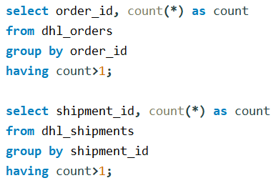

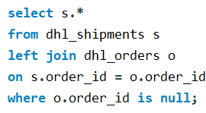
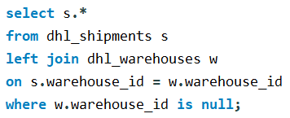
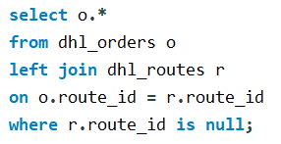
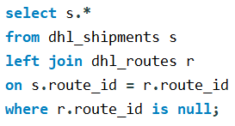


Task 1: Data Cleaning & Preparation
1. A data quality issue was identified where shipments with zero delay hours had incorrect delay reasons; this was corrected by standardizing such records to “No Delay” to ensure accurate delay analysis.
2. No duplicate records were found in any table.
3. No null or missing delay hours values were found in the shipments table.
4. All date fields were standardized to YYYY-MM-DD HH:MM:SS format using SQL date functions to ensure consistency and enable accurate time-based analysis.
5. Shipment timelines were validated to ensure that no delivery date occurred before the pickup date, and no inconsistencies were found.
6. Referential integrity across Orders, Routes, Warehouses, and Shipments was validated, and no orphan or inconsistent records were found.

Slide 3

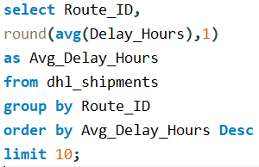
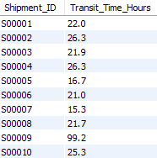

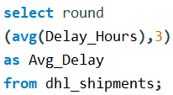
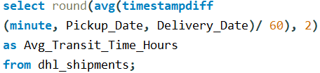

Task 2: Delivery Delay Analysis
Transit time across shipments varies widely, ranging from approximately 10 hours to 280 hours, indicating significant differences in route efficiency and operational conditions.
The overall average transit time is ~ 53.4 hours, highlighting opportunities to optimize slower routes and reduce delivery duration.
The top 10 delayed routes show average delay hours ranging from ~21 to 41 hours, significantly higher than the overall average delay of ~21.4 hours.
Route R002 is the most delayed, with an average delay of approximately 41 hours, indicating a major operational bottleneck.
Multiple routes consistently exceed 30 hours of average delay, suggesting systemic issues such as congestion or unrealistic transit planning.
These routes should be prioritized for route redesign, SLA review, and capacity optimization to reduce delivery delays.

Slide 4

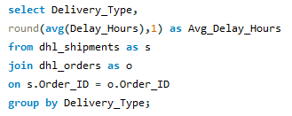
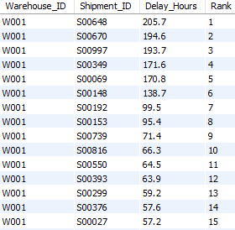
Task 2: Delivery Delay Analysis
Within each warehouse, shipments were ranked by delay, revealing that the top-ranked shipments account for the highest delay hours compared to others.
In several warehouses, the top 1–2 shipments show delays multiple times higher than the warehouse average.
This ranking enables warehouses to focus on a small number of high-delay shipments that drive a majority of delay impact.
Express deliveries have a higher average delay of approximately 22.5 hours compared to 20.9 hours for Standard deliveries.
Both delivery types are close to the overall average delay of ~21.4 hours, indicating system-wide delay factors.
Despite premium positioning, Express shipments require focused optimization to meet faster service-level expectations.

Slide 5
Task 2: Delivery Delay Analysis (KEY INSIGHTS & RECOMMENDATIONS)
Key Insights
The overall average delivery delay is ~21.4 hours, indicating notable inefficiencies in the delivery network.
Top delayed routes show average delays ranging from ~21 to 41 hours, with Route R002 (~41 hours) being the most critical bottleneck.
Express deliveries (22.5 hours) experience slightly higher delays than Standard deliveries (20.9 hours), despite premium service expectations.
Shipment-level ranking reveals that a small number of highly delayed shipments significantly impact warehouse and route performance.
Business Recommendations
Prioritize optimization of high-delay routes (especially those exceeding 30+ hours average delay) through route redesign and SLA review.
Improve Express delivery operations by reallocating resources and tightening monitoring to meet promised service levels.
Focus corrective actions on top-ranked delayed shipments within each warehouse to reduce overall delay impact efficiently.
Regularly monitor delay trends to proactively identify emerging bottlenecks and prevent systemic delays.
Outcome Expected
Improved delivery reliability
Better SLA compliance
Reduced operational delays
Enhanced customer satisfaction

Slide 6
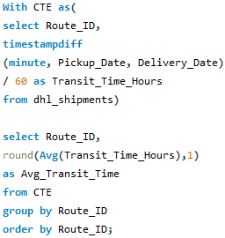
Task 3: Route Optimization Insights
The overall average transit time is ~53.4 hours, serving as a benchmark for route performance. Significant variation exists across routes, with average transit times ranging from ~28.6 hours to ~84.3 hours. Routes such as R004 (~84.3 hours) and R018 (~76.2 hours) exhibit the highest transit times, indicating long-haul or inefficient routing. In contrast, routes like R015 (~28.6 hours) and R009 (~28.7 hours) demonstrate relatively faster delivery performance. Several routes exceed 60+ hours, suggesting potential congestion, distance challenges, or operational bottlenecks. These high-transit routes should be prioritized for optimization through route redesign, capacity planning, or revised transit expectations.

Slide 7
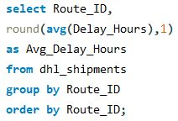
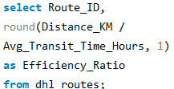
Task 3: Route Optimization Insights
The overall average delay is ~21.4 hours, serving as a baseline to compare route performance. Routes such as R002 (~41 hours) and R007 (~34 hours) experience the highest average delays, indicating major operational inefficiencies. Several routes consistently exceed 30 hours of delay, highlighting the need for targeted route optimization. Lower-delay routes (below 10 hours) demonstrate more stable and efficient delivery performance.
The distance-to-time efficiency ratio varies widely across routes, ranging from approximately 38 km/hr to over 545 km/hr. Routes such as R019 (~545 km/hr) and R010 (~540 km/hr) demonstrate the highest efficiency, indicating faster movement per hour. In contrast, routes like R003 (~38 km/hr) and R015 (~53 km/hr) show low efficiency, suggesting congestion or operational delays. Low-efficiency routes should be prioritized for optimization to improve overall delivery performance.

Slide 8
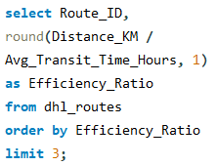
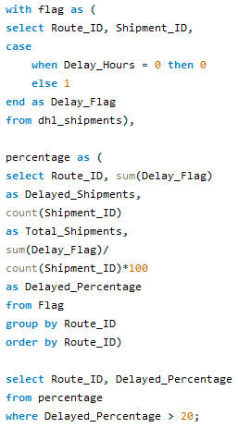
Task 3: Route Optimization Insights
The three least efficient routes are R003 (~37.7 km/hr), R015 (~52.7 km/hr), and R006 (~101.5 km/hr), indicating slow movement relative to distance. These routes fall well below the efficiency levels of most other routes, highlighting significant operational bottlenecks. Prioritizing optimization for these routes can help reduce transit time and improve overall network efficiency.
All analysed routes show delay percentages well above 20%, with values ranging from approximately 82% to nearly 100%. Several routes, including R009, R012, and R010, exhibit extremely high delay rates (>98%), indicating persistent SLA breaches. Such consistently high delay percentages suggest systemic issues in route planning or expected transit time assumptions. These routes should be prioritized for immediate review, SLA recalibration, and operational optimization.

Slide 9
Task 3: Route Optimization Insights (KEY INSIGHTS & RECOMMENDATIONS)
Key Insights
The overall average transit time is ~53.4 hours, with significant variation across routes ranging from ~28.6 to ~84.3 hours.
Certain routes (e.g., R004, R018) show consistently high transit times, indicating long-haul distance challenges or routing inefficiencies.
Average delay per route varies widely, with some routes exceeding 40 hours of delay, far above the network average of ~21.4 hours.
The distance-to-time efficiency ratio ranges from ~38 km/hr to over 545 km/hr, highlighting large performance gaps between routes.
Routes such as R003, R015, and R006 are the least efficient, while multiple routes show delay percentages above 80%, indicating frequent SLA breaches.
Business Recommendations
Prioritize optimization of low-efficiency routes by reviewing route design, traffic patterns, and transit schedules.
Reassess expected transit times (SLAs) for routes with consistently high delay percentages to ensure realistic planning.
Introduce route-specific strategies such as alternative paths, intermediate hubs, or capacity reallocation for high-risk routes.
Continuously monitor route KPIs to proactively identify emerging bottlenecks and improve delivery reliability.
Outcome Expected
Improved route efficiency and reduced transit time
Better SLA adherence and fewer delivery delays
Enhanced network reliability and customer satisfaction

Slide 10
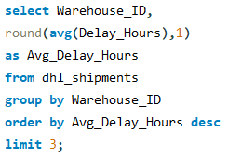
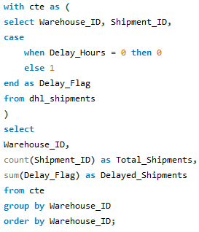
Task 4: Warehouse Performance
Warehouse W004 has the highest average delay at approximately 25.9 hours, making it the most critical bottleneck. W003 (25.5 hours) and W008 (24.4 hours) also show consistently high delays compared to other warehouses. These warehouses should be prioritized for process optimization and capacity planning to reduce dispatch delays. Across all warehouses, a large proportion of shipments are delayed, with delayed shipments closely tracking total shipment volumes. Warehouse W008 handles the highest shipment volume (~112 shipments) and also records a high number of delayed shipments (~100). Warehouses such as W001, W003, and W010 show consistently high delay counts relative to total shipments. These patterns indicate the need for warehouse-level process improvements and capacity optimization to reduce dispatch delays.

Slide 11
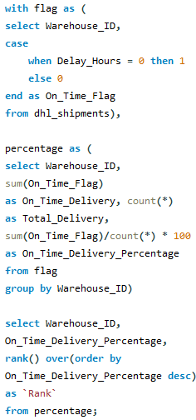
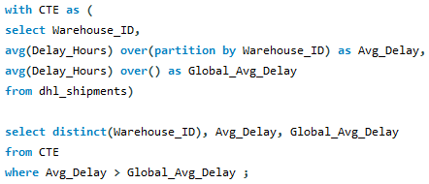
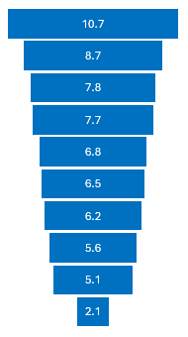
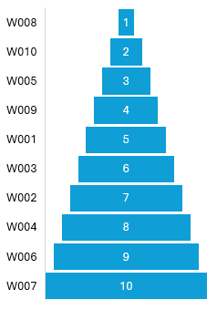
Task 4: Warehouse Performance
Warehouse Rank based on On-Time Delivery Percentage.
The global average delay is ~21.4 hours, serving as a benchmark for warehouse performance. Warehouses W003, W004, W005, W007, W008, and W010 exceed the global average, indicating below-average dispatch efficiency. W004 (~25.9 hours) and W003 (~25.5 hours) show the highest deviation from the global benchmark. Warehouse W008 ranks highest in on-time delivery performance with an on-time percentage of approximately 10.7%. Warehouses W010 (8.7%) and W005 (7.8%) follow closely, indicating relatively better dispatch reliability. W007 ranks lowest with an on-time delivery percentage of only ~2.1%, highlighting severe performance issues. Overall, low on-time percentages across warehouses suggest the need for systemic improvements in warehouse operations and scheduling.

Slide 12
Task 4: Warehouse Performance (KEY INSIGHTS & RECOMMENDATIONS)
Key Insights
Warehouses W004 (~25.9 hrs), W003 (~25.5 hrs), and W008 (~24.4 hrs) record the highest average delay hours, indicating major dispatch inefficiencies.
Across all warehouses, delayed shipments account for a large proportion of total shipments, suggesting systemic warehouse-level issues.
The global average delay is ~21.4 hours, with multiple warehouses (W003, W004, W005, W007, W008, W010) exceeding this benchmark.
On-time delivery performance is generally low, with W008 leading at ~10.7% and W007 lagging at ~2.1%, highlighting wide performance gaps.
Business Recommendations
Prioritize operational reviews for high-delay warehouses (especially W004 and W003) to identify process bottlenecks.
Improve warehouse scheduling, staffing, and dispatch workflows to reduce delays and increase on-time performance.
Rebalance shipment volumes to prevent overloading high-delay warehouses and better utilize lower-delay facilities.
Implement continuous monitoring of warehouse KPIs to drive accountability and performance improvement.
Outcome Expected
Reduced warehouse dispatch delays
Improved on-time delivery performance
Better utilization of warehouse capacity
Enhanced overall logistics reliability

Slide 13
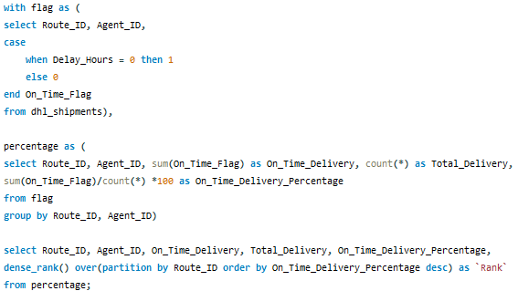
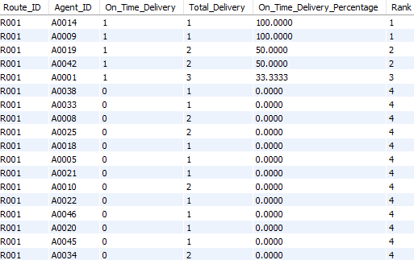
Task 5: Delivery Agent Performance
Delivery agents were ranked by on-time delivery percentage within each route, resulting in a detailed performance table of ~ 645 agent–route records. On-time delivery performance shows significant variation among agents operating on the same route, indicating that delays are not purely route-driven. On-time delivery percentages range from very low single-digit values to higher double-digit values, reflecting wide performance disparities. A small group of agents consistently ranks at the top within their routes, demonstrating reliable and efficient delivery execution. Conversely, lower-ranked agents contribute to a disproportionately high share of delayed shipments. This ranking enables targeted performance management, including focused training, route reassignment, and incentive-based improvements. Overall, agent-level insights complement route and warehouse analysis to improve end-to-end delivery reliability.

Slide 14
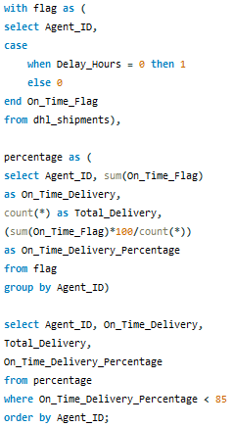
Task 5: Delivery Agent Performance
All delivery agents have an on-time delivery percentage below 85%, indicating widespread performance challenges. On-time percentages range from ~23.8% at the highest to 0% for several agents, showing extreme variation in agent performance. Multiple agents record single-digit or zero on-time percentages, highlighting critical reliability issues. Only a small subset of agents achieve on-time performance above 15–20%, suggesting limited consistency across the workforce. These findings emphasize the need for targeted training, performance monitoring, and route reassignment for low-performing agents.

Slide 15
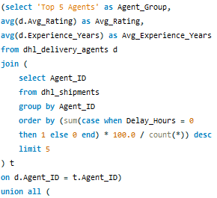
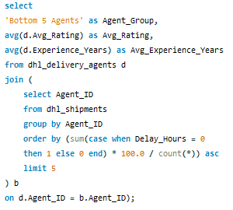
Task 5: Delivery Agent Performance
The Top 5 agents have an average rating of approximately 4.42 with an average experience of ~2.34 years. The Bottom 5 agents show a slightly higher average rating of ~4.52, but similar experience levels at ~2.40 years. This indicates that higher ratings or experience alone do not guarantee better on-time performance. Delivery efficiency appears to be influenced more by operational factors such as route conditions and workload rather than agent tenure or ratings alone.
Analysis shows most delivery agents have on-time delivery percentages below 85%, with several agents performing in the 0–10% range. Targeted training is recommended for low-performing agents, while high-risk routes should be balanced by assigning them to agents with 20%+ on-time performance. These actions are expected to improve agent efficiency and overall delivery reliability.

Slide 16
Task 5: Delivery Agent Performance (KEY INSIGHTS & RECOMMENDATIONS)
Key Insights
Delivery agent performance shows high variability, with on-time delivery percentages ranging from ~0% to ~24% across agents.
A large majority of agents perform below the 85% on-time benchmark, indicating widespread reliability challenges.
Agent–route ranking (~645 records) reveals that agents on the same route often perform very differently, suggesting that delays are not purely route-driven.
Comparison of the Top 5 vs Bottom 5 agents shows similar average ratings (~4.4–4.5) and experience (~2.3–2.4 years), indicating that ratings and tenure alone do not guarantee better delivery performance.
Business Recommendations
Provide targeted training for agents with on-time performance below 10%, focusing on route familiarity, time management, and exception handling.
Implement workload balancing by assigning complex or high-delay routes to consistently high-performing agents (20%+ on-time performance).
Introduce performance-based monitoring and incentives to encourage improvement and accountability.
Regularly review agent-level KPIs to identify early performance issues and take corrective action.
Outcome Expected
Improved agent-level delivery reliability
Reduced shipment delays caused by execution issues
Better alignment of agent skills with route complexity
Enhanced overall service quality and customer satisfaction

Slide 17
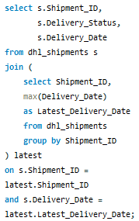
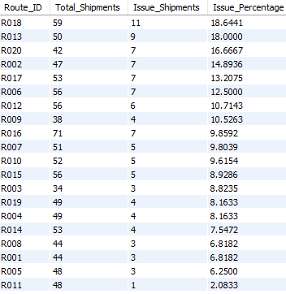
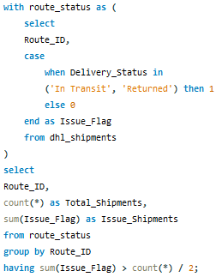
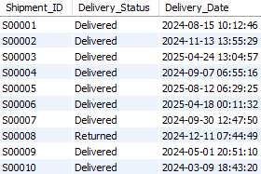
Task 6: Shipment Tracking Analytics
Out of 1000 shipments, 895 shipments (~89%) have a final status of Delivered, indicating strong overall delivery completion. A smaller share of shipments are still In Transit (~9%), while only ~2% are Returned, suggesting limited delivery failures. Using the latest delivery date ensures shipment status reporting reflects the most current and accurate operational state.
Several routes have a high proportion of shipments still unresolved, with Route R018 showing the highest issue rate at ~18.6%. Routes such as R013 (~18.0%), R020 (~16.7%), and R002 (~14.9%) also exhibit a significant share of shipments marked as In Transit or Returned. Although no route exceeds the 50% threshold, these routes show comparatively higher operational risk and require closer monitoring. Targeted intervention on these routes can help reduce unresolved shipments and improve overall delivery completion rates.

Slide 18
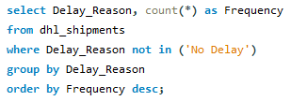
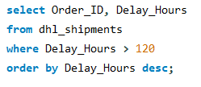
Task 6: Shipment Tracking Analytics
Traffic-related delays are the most frequent, accounting for ~51% (474 cases) of all delayed shipments. Weather issues contribute to ~31% (292 cases) of delays, indicating external environmental impact on delivery performance. Technical issues account for ~18% (166 cases), highlighting internal operational challenges. These insights suggest that traffic management and contingency planning should be key focus areas to reduce overall delays.
Out of 1000 total Shipments, 52 orders (~ 5.2%) experienced exceptionally high delays exceeding 120 hours, indicating a notable subset of critical cases. The highest delays reach up to ~239 hours, with many orders falling in the 150–200+ hour range. These extreme delays point to systemic bottlenecks such as route disruptions, warehouse congestion, or exception handling gaps. Focusing root-cause analysis on these 52 high-delay orders can significantly improve overall delivery performance.

Slide 19
Task 6: Shipment Tracking Analytics (KEY INSIGHTS & RECOMMENDATIONS)
Key Insights
Out of approximately 1000 shipments, ~89% (895) have been successfully Delivered, while ~9% remain In Transit and ~2% are Returned, indicating strong completion but some unresolved cases.
Certain routes such as R018 (~18.6%), R013 (~18.0%), R020 (~16.7%), and R002 (~14.9%) show a relatively higher proportion of shipments still In Transit or Returned, posing operational risk.
Traffic delays are the most frequent delay reason (~51%, 474 cases), followed by Weather (~31%, 292 cases) and Technical Issues (~18%, 166 cases).
From 300 total orders, 52 orders experienced exceptionally high delays (>120 hours), with delays reaching up to ~239 hours, indicating severe bottlenecks.
Business Recommendations
Closely monitor routes with higher unresolved shipment percentages and implement proactive intervention to reduce In Transit and Returned cases.
Address traffic-related delays through dynamic routing, buffer planning, and peak-hour delivery optimization.
Investigate high-delay orders (>120 hours) individually to identify root causes such as warehouse congestion, route disruption, or exception handling gaps.
Strengthen real-time shipment tracking and escalation mechanisms to prevent prolonged delays and improve delivery reliability.
Outcome Expected
Faster resolution of In Transit and Returned shipments
Reduced extreme delay cases
Improved shipment visibility and control
Enhanced customer satisfaction and SLA adherence

Slide 20

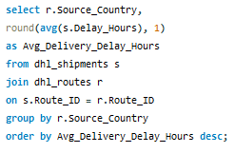
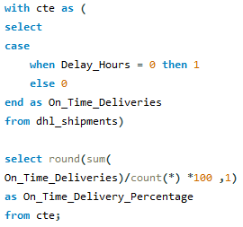
Task 7: Advanced KPI Reporting
Average delivery delay varies significantly by source country, ranging from ~9.7 hours (Canada) to ~41 hours (UAE). Countries such as UAE, Turkey, China, and Singapore show higher average delays (30+ hours), indicating upstream operational challenges. In contrast, Japan, Australia, South Africa, and Germany maintain relatively lower delays (below 14 hours), reflecting more efficient dispatch performance. These differences highlight the need for country-specific logistics optimization and SLA calibration. The overall On-Time Delivery Percentage is ~6.8%, indicating a significant gap between actual performance and expected service levels. This low on-time rate suggests that most shipments experience some level of delay, even if minor. The metric highlights systemic challenges across routes, warehouses, and agents rather than isolated issues. Improving on-time delivery should be a top operational priority to meet SLA commitments and customer expectations.

Slide 21
Task 7: Advanced KPI Reporting
Average delay hours vary widely across routes, ranging from ~6.8 hours (R001) to ~41.0 hours (R002). Routes R002, R007, R020, and R003 show the highest average delays (30+ hours), indicating persistent route-level inefficiencies. Mid-performing routes such as R004, R018, and R011 experience average delays between 20–26 hours. Several routes, including R001, R009, and R013, maintain comparatively lower delays (below 12 hours). This disparity highlights the importance of route-specific optimization strategies rather than a one-size-fits-all approach. Prioritizing high-delay routes can significantly reduce overall network-wide delivery delays.

Slide 22
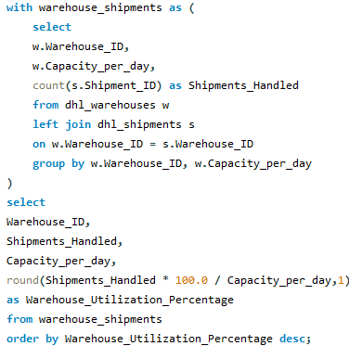
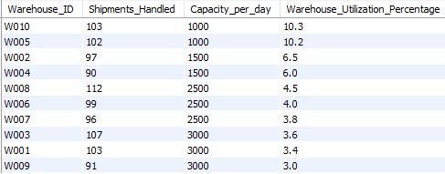
Task 7: Advanced KPI Reporting
Warehouse utilization remains relatively low across all facilities, ranging from ~3.0% (W009) to ~10.3% (W010). Warehouses W010 (10.3%) and W005 (10.2%) show the highest utilization, yet still operate far below full capacity. High-capacity warehouses such as W003 and W001 (3000 capacity/day) operate at below 4% utilization, indicating underuse of resources. Lower-capacity warehouses experience comparatively higher utilization, suggesting uneven workload distribution. This imbalance highlights opportunities for load redistribution and network-level optimization. Improving utilization can reduce per-unit operating costs and improve overall efficiency. Strategic capacity planning and demand alignment are required to better leverage existing infrastructure.

Slide 23
Task 7: Advanced KPI Reporting (KEY INSIGHTS & RECOMMENDATIONS)
Key Insights
Average Delivery Delay by Source Country shows strong variation, ranging from ~9.7 hours (Canada) to ~41 hours (UAE), indicating country-specific operational inefficiencies.
The overall On-Time Delivery Percentage is only ~6.8%, highlighting a major gap between actual performance and expected service levels.
Route-level delays vary widely, with average delays ranging from ~6.8 hours (R001) to ~41 hours (R002), confirming that certain routes consistently underperform.
Warehouse utilization is low across all facilities, ranging from ~3.0% to ~10.3%, indicating significant under-utilization of available capacity.
High-capacity warehouses (3000 shipments/day) operate below 4% utilization, while smaller warehouses show relatively higher usage.
Business Recommendations
Implement country-specific SLA targets and process improvements, especially for high-delay source countries like UAE, Turkey, and China.
Prioritize route optimization efforts for high-delay routes (R002, R007, R020, R003) to reduce network-wide delays.
Improve on-time delivery performance by addressing systemic causes such as traffic delays, warehouse congestion, and agent workload imbalance.
Redistribute shipment volumes to better utilize under-used warehouses, improving cost efficiency and operational balance.
Use these KPIs as continuous monitoring metrics to track improvements and support data-driven logistics decisions.
Outcome Expected
Reduced delivery delays and SLA breaches
Improved on-time delivery performance
Better warehouse capacity utilization
More resilient and optimized DHL logistics network

Slide 24
Final Summary: Key Insights & Business Recommendations
Key Insights
Overall On-Time Delivery performance is low (~6.8%), indicating widespread SLA breaches across routes, warehouses, and agents.
Route-level inefficiencies are significant, with average delays ranging from ~6.8 hours to ~41 hours, requiring targeted optimization.
Traffic (51%) and Weather (31%) are the leading causes of delays, highlighting both operational and external risk factors.
Warehouse utilization is critically low (3%–10%), suggesting underutilized capacity and uneven workload distribution.
Agent performance varies widely (0%–24%), and ratings or experience alone do not strongly correlate with delivery reliability.
Business Recommendations
Prioritize high-delay routes and source countries (e.g., UAE, Turkey, China) for route redesign and SLA recalibration.
Improve on-time delivery performance through dynamic routing, traffic-aware scheduling, and proactive exception handling.
Rebalance shipment volumes to better utilize underused warehouses, improving cost efficiency and throughput.
Implement targeted training and workload balancing for low-performing delivery agents.
Establish continuous KPI monitoring dashboards to track delays, utilization, and SLA compliance in real time.
Expected Business Impact
Reduced delivery delays and extreme delay cases
Improved SLA adherence and customer satisfaction
Better utilization of logistics infrastructure
More resilient and data-driven DHL logistics operations
Focus optimization efforts on high-delay routes, low on-time delivery areas, and underutilized warehouses through data-driven routing, capacity balancing, and targeted agent training to improve overall DHL logistics performance.

Slide 25
Video Link: https://drive.google.com/file/d/1y4_bmdRfXY7KHTZazjETWCZuXegb9FgD/view?usp=drive_link

